Slide 1


UNIVERSITY INSTITUTE OF ENGINEERING
Academic Unit V
Bachelor of Engineering
(Computer Science & Engineering)
Biology For Engineers
23SZT-148
Biology for Engineers
INTRODUCTION
DISCOVER . LEARN . EMPOWER

Slide 2

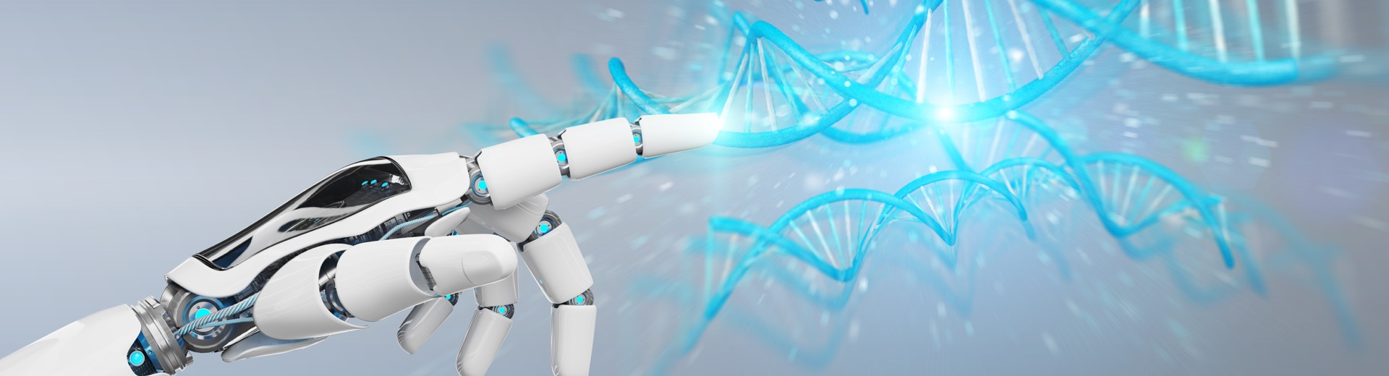
INTRODUCTION
Course Objective
This subject is designed to impart fundamental knowledge on basic of genetics and emerging fields of biology like biomedical recording system and medical instrumentation.
It is designed to impart knowledge that how to apply basics of biology in engineering.
https://www.uic.es/sites/default/files/uic-grau-bioenginyeria-hero-header_1.jpg
Biology for Engineers

Slide 3
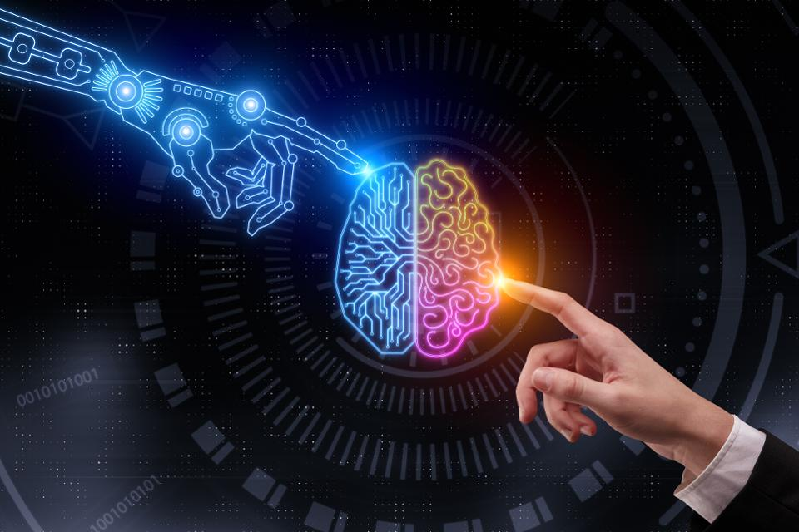
INTRODUCTION
Space for visual (size 24)
Course Outcome
CO Number | Title | Level
CO1 | Identify the biological concepts from an engineering perspective. | knowledge
CO2 | Development of artificial systems mimicking human action. | Understand
CO3 | Explain the basic of genetics that helps to identify and formulate problems | Analyze
CO4 | Apply knowledge of measurement system, biomedical recording system and biosensors to excel in areas such as entrepreneurship, medicine, government, and education. | Apply
CO5 | Integrate biological principles for developing next generation technologies, | Create
Will be covered in this lecture
https://specials-images.forbesimg.com/imageserve/1034901762/960x0.jpg?fit=scale
Biology for Engineers

Slide 4
SYLLABUS
Unit-1 | Importance of Biology In Engineering | Contact Hours: 15
Chapter 1 Significance of Biology in Engineering Chapter 2 Genetics | Introduction: Fundamental Differences between Science and engineering by drawing a comparison between eye and camera, Bird flying and aircraft. Significance of Biology in Engineering, Discuss how biological observations of 18th Century that lead to major discoveries, Examples from Brownian motion and the origin of thermodynamics by referring to the original observation of Robert and Julius Mayor. Genetics: Mendel’s laws, Concept of segregation and independent assortment, concept of allele, gene mapping, Gene interaction, Epitasis, Meiosis and Mitosis as a part of genetics. Mechanism of how genetic material passes from parent to offspring. Concepts of recessiveness and dominance. Concept of mapping of phenotype to Genes, single gene disorders in humans, concept of complementation using human genetics.
Biology for Engineers

Slide 5
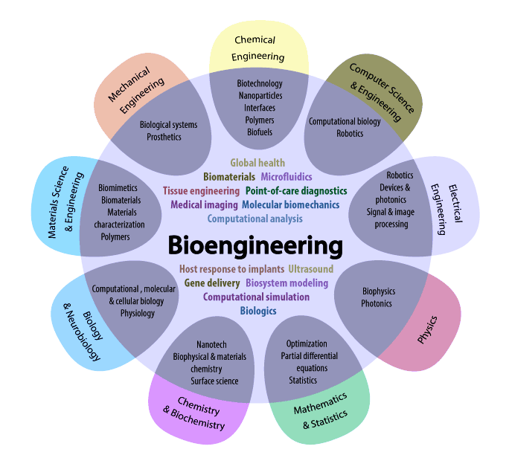
WHY DO WE NEED TO KNOW BIOLOGY
To find solutions to challenges, that face mankind
Biology is us, we are all biological creatures
Biology for Engineers
https://i.pinimg.com/originals/68/c9/30/68c930e95113ceb2e3dfc9de2f164680.png

Slide 6

DIFFERENCE BETWEEN SCIENCE AND ENGINEERING
Biology for Engineers

Slide 7
Fundamental Difference between Science and Engineering
Generally, Science is the study of the physical world/ nature, while Engineering applies scientific knowledge to design processes, structures or equipment.
Both Engineers and Scientists will have a strong knowledge of science, mathematics and technology, but Engineering students will learn to apply these principles to designing creative solutions to Engineering challenges.
So when we think of a scientist versus engineer, the two aren’t separate entities but belong to each other – without science, there wouldn’t be engineering
Biology for Engineers

Slide 8
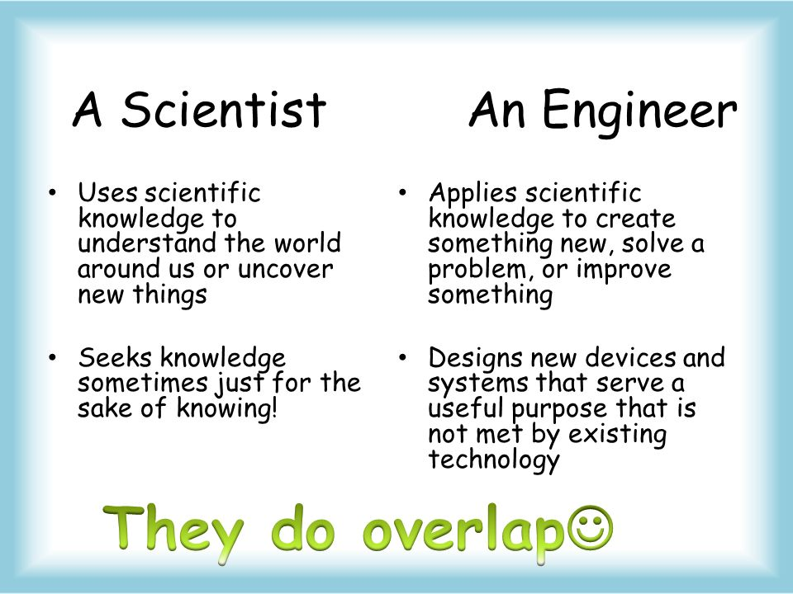
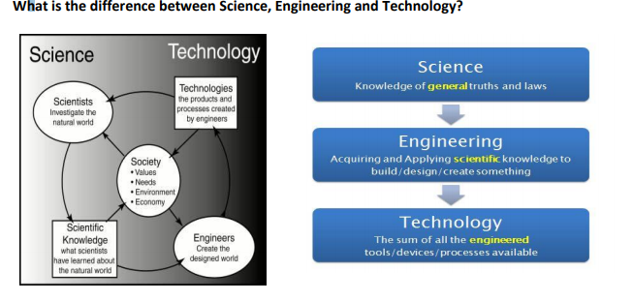
Biology for Engineers
https://qph.fs.quoracdn.net/main-qimg-36e90eb8a3984ab484ff3888b4376e36.webp

Slide 9
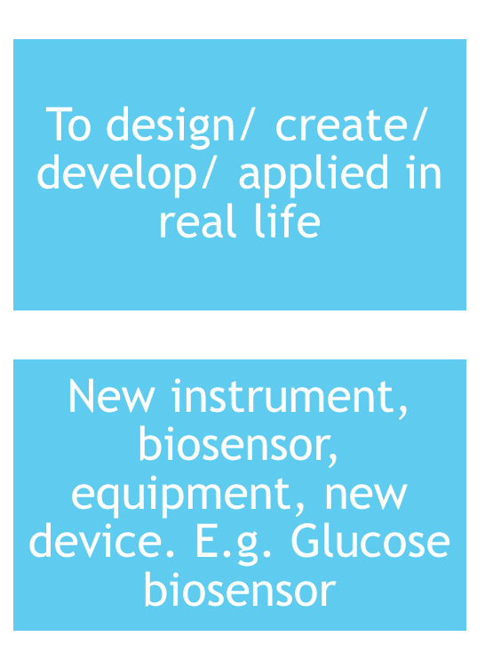

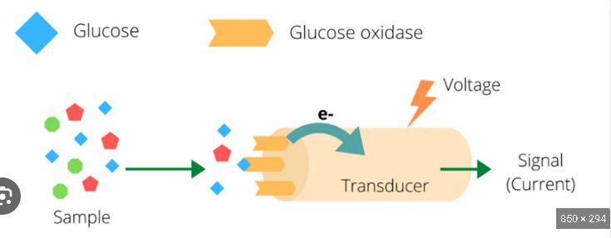
Engineering
Engineering, the application of science and math to solve problems.
Engineering is the creative application of scientific principles to design or develop structures, machines, apparatus.
Biology for Engineers

Slide 10
BIOLOGY
Biology is the natural science that studies life and living organisms, including their physical structure, chemical processes, molecular interactions, physiological mechanisms, development and evolution.
There are three major branches of biology – botany, zoology and microbiology.
BOTANY study of plants
ZOOLOGY study of animals
MICROBIOLOGY study of microbes
Biology for Engineers

Slide 11
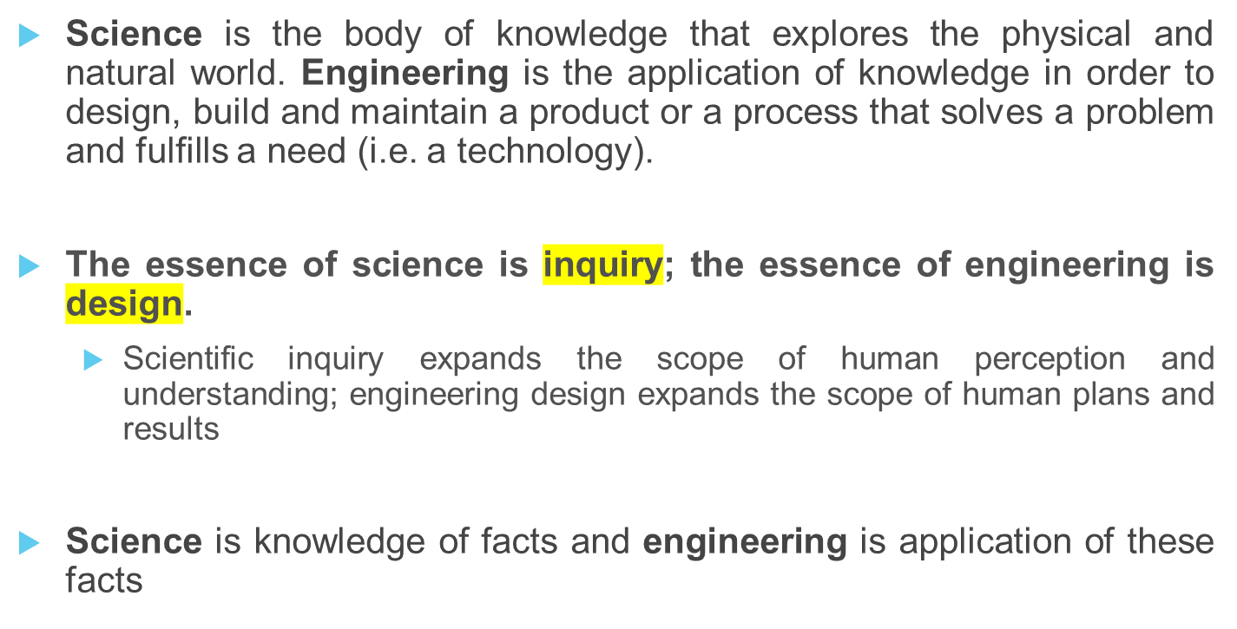
What’s the simple definition?
Biology for Engineers

Slide 12
What’s the goal?
Scientists and engineers have different goals.
  Scientists seek to describe and understand the natural world.
  Engineers consider various criteria and constraints in order to design solutions to problems, needs and wants that better the lives of humans, animals and/or the environment.
Biology for Engineers

Slide 13
COMPARISON BETWEEN EYE AND CAMERA
Biology for Engineers

Slide 14
Comparison between eye and camera
Eye is an organ of sight while a camera is equipment that is used to record images
How eye works….. The facts gathered by using different fields of science (like biology, physics etc.) and then human engineered camera by using these facts
Biology for Engineers

Slide 15
Comparison between eye and camera
The human eye lets us see the world by sending impulses to our nervous system. In many ways, it is very similar to other optical devices, including cameras.
Your eyes and your brain work together to allow you to see. In fact, human eyes and brains have been coevolving for millions of years.
Your eyes are a bit like something else that captures images of the world: a camera.
Biology for Engineers

Slide 16
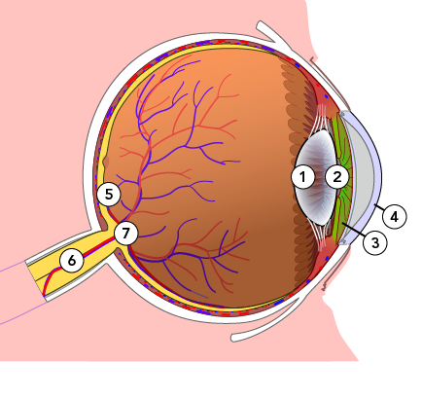
How are an eye and a camera similar?
An eye and a camera both have lenses and light-sensitive surfaces.
Your iris controls how much light enters your eye.
  Your lens helps focus the light.
  The retina is a light-sensitive surface at the back of your eye. It captures an image of what you’re looking at.
  Then, the retina sends impulses to your brain along the optic nerve. Finally, the brain interprets what you’re seeing.
A human eye has a lens (1), pupil (2), iris (3), cornea (4), retina (5), optic nerve (6), and blind spot (7)
Biology for Engineers

Slide 17
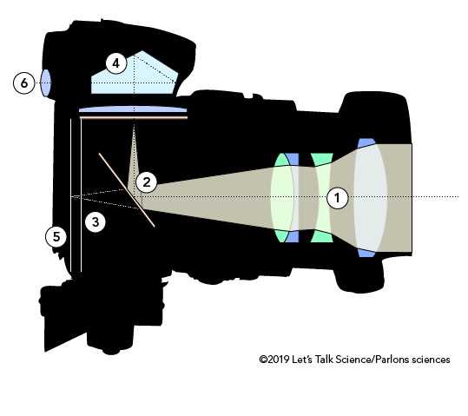
How are an eye and a camera similar?
This is similar to what happens when a camera captures an image.
  First, light hits the surface of the camera’s lens.
  The aperture controls how much light enters the camera.
  Then, the light makes its way to a light-sensitive surface.
  For a long time, this surface was the camera’s film. In today’s digital cameras, this surface is an imaging sensor chip.
Cross-section of a single-lens reflex (SLR) camera (© 2019 Let’s Talk Science)
An SLR camera has a lens (1), mirror (2), aperture (3), prism (4), film or imaging sensor (5) and eyepiece (6)
Biology for Engineers

Slide 18
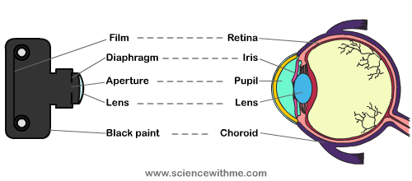
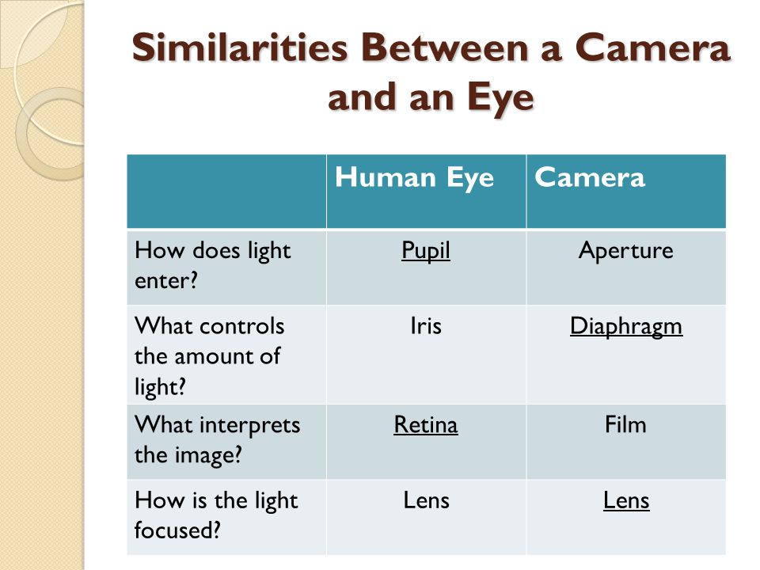
ANATOMY OF CAMERA & EYE
Biology for Engineers
https://sites.google.com/site/humaneye12/_/rsrc/1329590059679/resume/eye2C.png

Slide 19
Cornea and Lens
The cornea is the “cap” of the eye. This transparent (like clear jelly) structure sits to the front of the eye and has a spherical curvature.
The lens of a camera is also transparent (glass) and sits at the front of the body.
Like the cornea, the lens also maintains a curvature.
Iris and Aperture
Light adjustment: Both the eye and a camera can adjust quantity of light entering.
  On a camera, it’s done with the aperture control built into your lens, whilst in your eye, it’s done by having a larger or smaller iris.
Biology for Engineers

Slide 20
Focus in Eyes and Cameras
Image focusing: Human and camera lenses both focus an inverted image onto light-sensitive surface.
  In the case of a camera, it’s focused onto film or a sensor chip.
  In your eyes, the light-sensitive surface is the retina on the inside of your eyeball.
Both the eye and camera have the ability to focus on one single object and blur the rest, whether in the foreground (shallow depth of field) or off at a distance.
Likewise, the eye can focus on a larger image, just as a camera (greater depth of field) can focus and capture a large scape.
Biology for Engineers

Slide 21
How are an eye and a camera different?
The human eye contains small muscles that contract and relax – and this enables the lenses in your eyes to change shape and stay focused on a moving object.
These muscles also capable of changing the thickness of the lens to accommodate the image being viewed.
A camera lens can’t do this. That’s why photographers change lenses, depending on how far away they are from an object. Mechanical parts in the camera lens also adjust to stay focused on a moving object.
Biology for Engineers

Slide 22
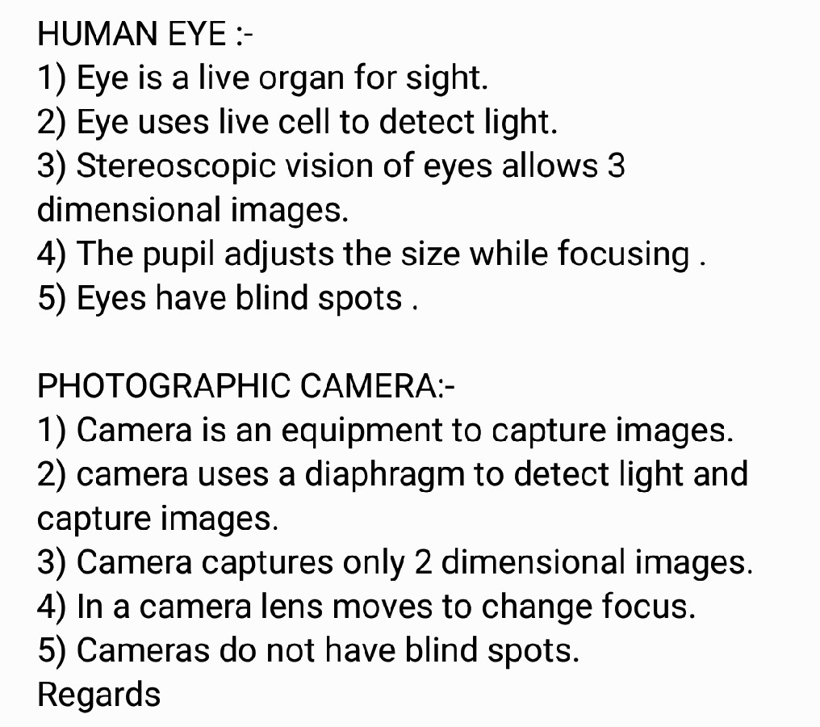
How else are your eyes different from a camera?
Because a camera has photoreceptors all over its lens, it always sees a “full” picture.
Your eyes, on the other hand, optic nerve connects to the retina. It has no photoreceptors at all.
Sensitivity to light: A film in a camera is sensitive to light. The human retina is not. Therefore, quality and power of capturing of our eyes have a greater sensitivity in dark locations than a typical camera.
Biology for Engineers

Slide 23
References
Biomimicry: Innovation Inspired by Nature28 Jul, 2009 by Janine M. Benyus.
Video link: https://www.digimat.in/nptel/courses/video/121106008/L01.html
https://youtu.be/ld3A065dELc
https://medium.com/photography-secrets/whats-the-difference-between-a-camera-and-a-human-eye-a006a795b09f
https://letstalkscience.ca/educational-resources/stem-in-context/eye-vs-camera
https://unfoldanswers.com/5-similarities-between-birds-and-aircraft/
https://nptel.ac.in/courses/121/106/121106008/
https://www.utoledo.edu/engineering/bioengineering/undergrad/prospective/whatisbioe.html#:~:text=Bioengineering%20is%20the%20application%20of,health%20care%20and%20other%20fields.
https://i.pinimg.com/originals/68/c9/30/68c930e95113ceb2e3dfc9de2f164680.png
https://youtu.be/FBUpnG1G4yQ
Biology for Engineers

Slide 24

Biology for Engineers

